Slide 1
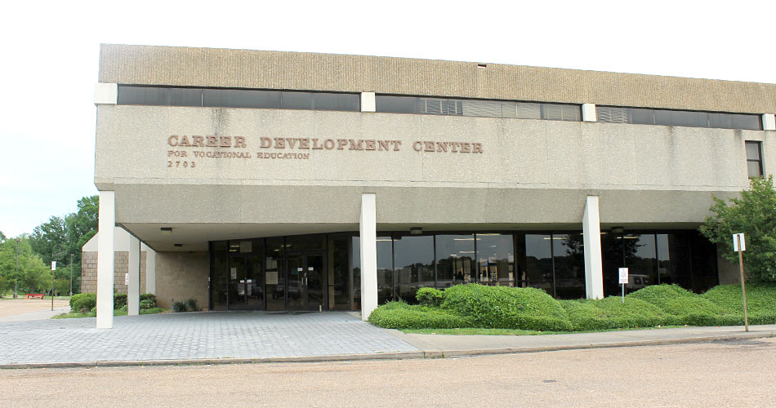
About the Career Development Center

